Slide 1
TWITTER HERON
By
Akhilesh Gattu (5)
Latha Muddu (15)

Slide 2
Heron
Better debugging capabilities
Performance
Easy to manage

Slide 3
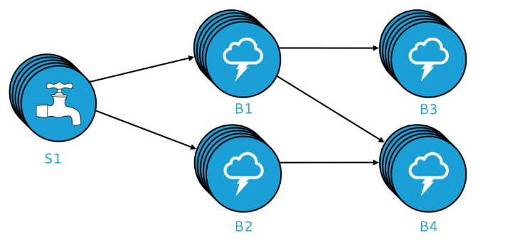
Heron Topology

Slide 4
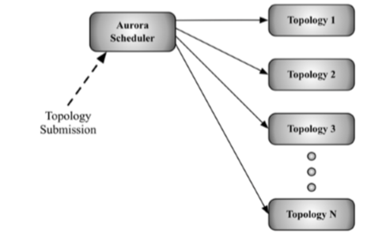
Architecture

Slide 5
Aurora scheduler
Users employ heron API to create and deploy topologies to aurora scheduler
Each heron topology consists of multiple containers, allocating and scheduling these containers is done by Aurora.

Slide 6
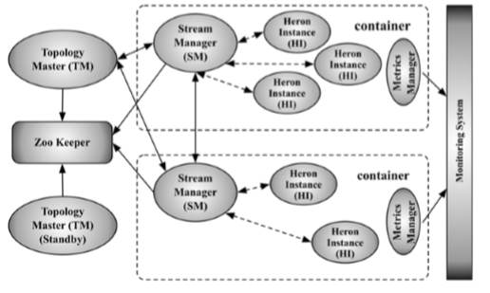
Topology architecture

Slide 7
Heron architecture Contd…
Topology Master – Responsible for managing topology throughout the existence of the topology
Zookeeper – Responsible for maintaining state
Stream manager- Manages routing of tuples between topology components
Metrics manager – Collects and exports metrics from all the components in the system
Heron Instance – It is a process that handles single task of spout or bolt

Slide 8
Tuple Processing
At most once - no tuple is processed more than once, although some tuples may be dropped, and thus may miss being analyzed by the topology
At least once - – each tuple is guaranteed to be processed at least once, although some tuples may be processed more than once, and may contribute to the result of the topology multiple times.

Slide 9
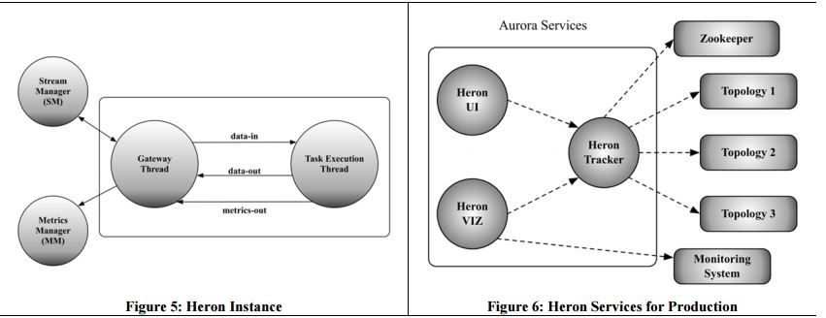
Heron instance and services

Slide 10
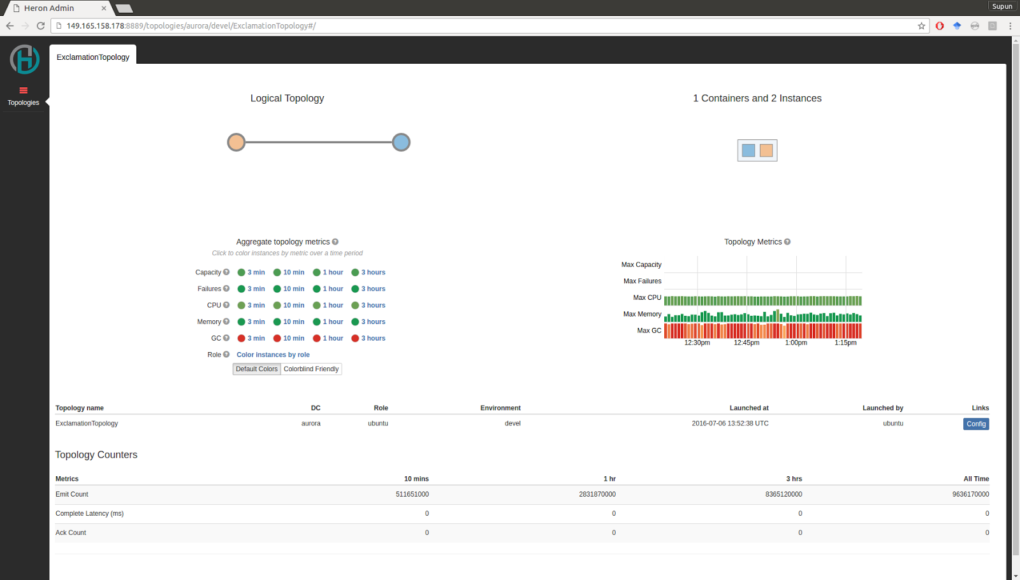
Heron UI

Slide 11
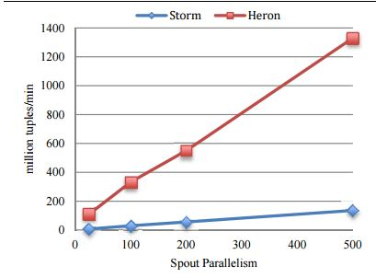
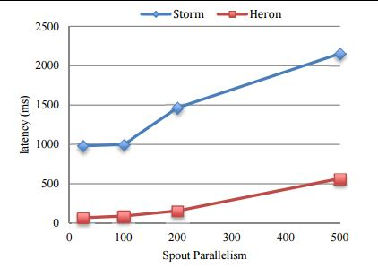
Heron vs storm Throughput and end to end latency

Slide 12
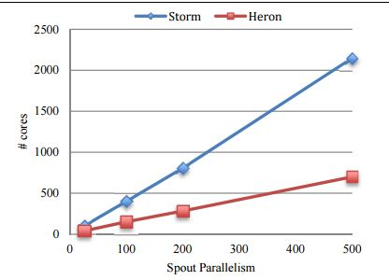
Heron vs storm cpu usage

Slide 13
Twitter use case
Real Time Trends - Twitter is a continuous stream of tweets and in this stream, you need to identify the emerging top 10 trends.
Real Time BI – Counting the number of tweets based on the source - break down by mobile/web, what mobile operating system, a crude sense of location, etc
Heatmap of Tweets - Some % of tweets contains latitude and longitude. Get those tweets continuously and update the google maps to see where the tweets are coming from and view them globally in a map

Slide 14
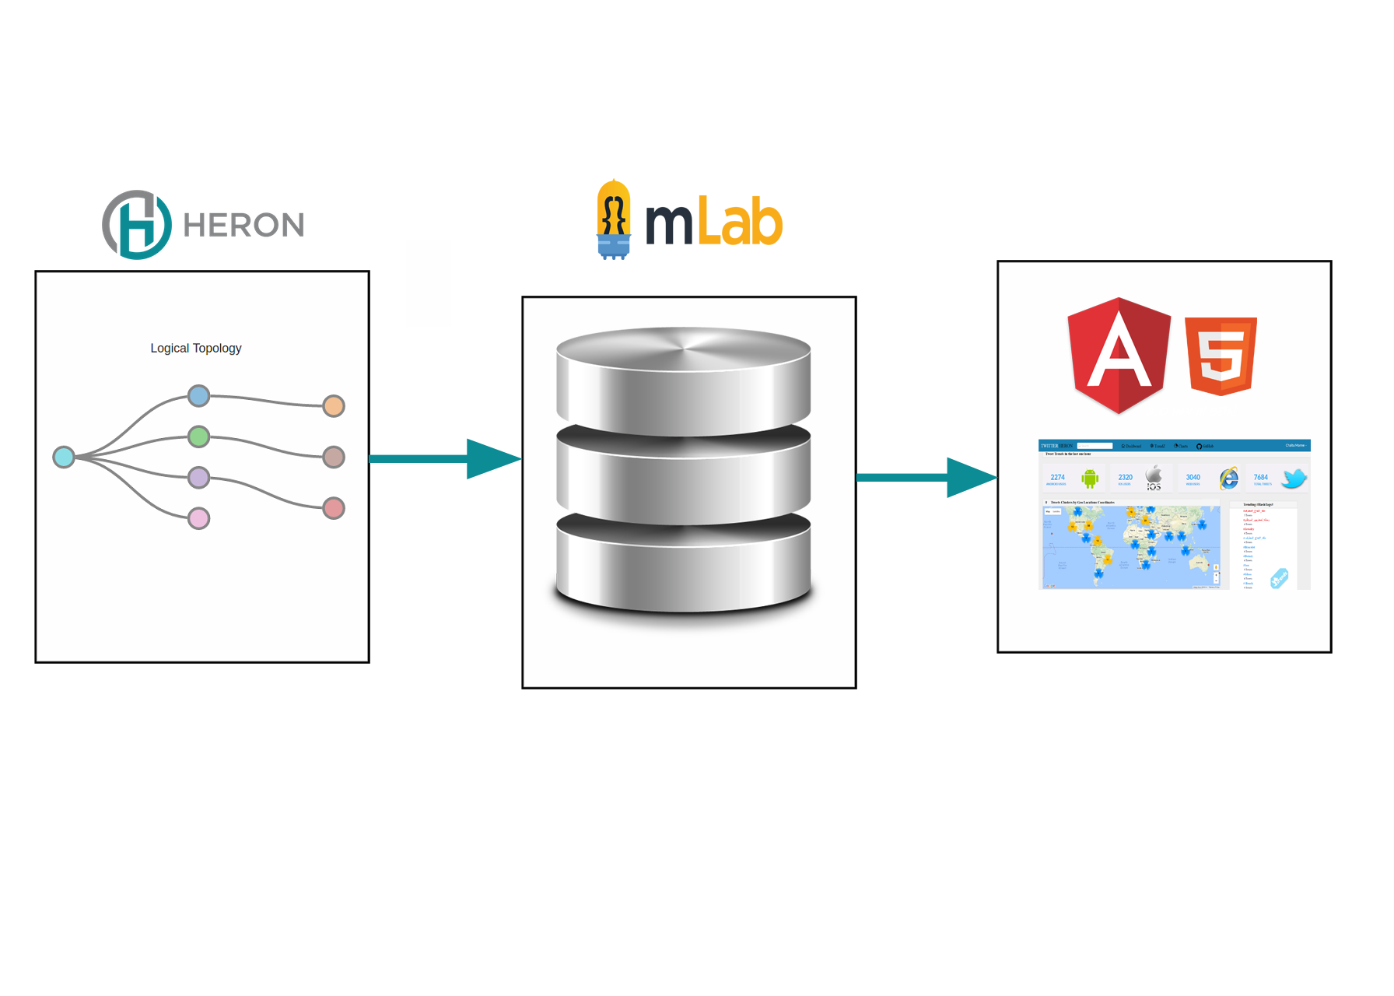
Twitter heron Use case architecture

Slide 15
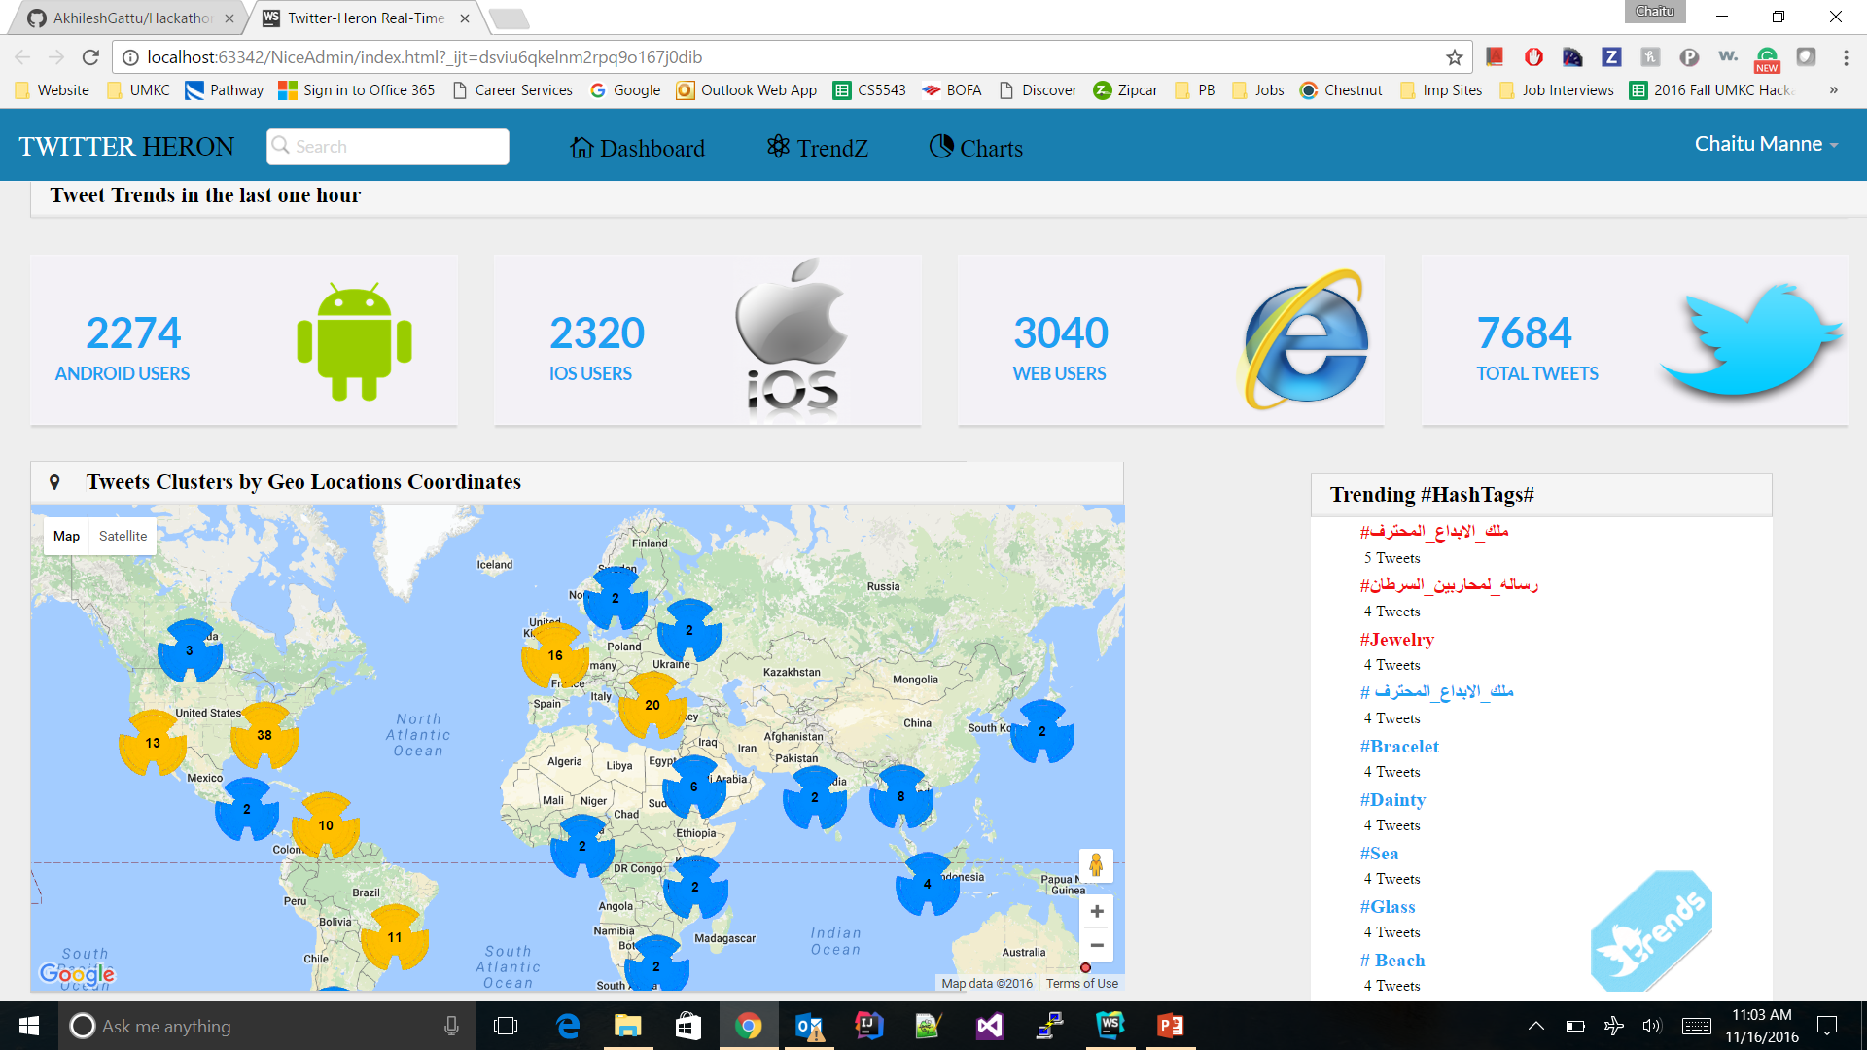
Implementation

Slide 16
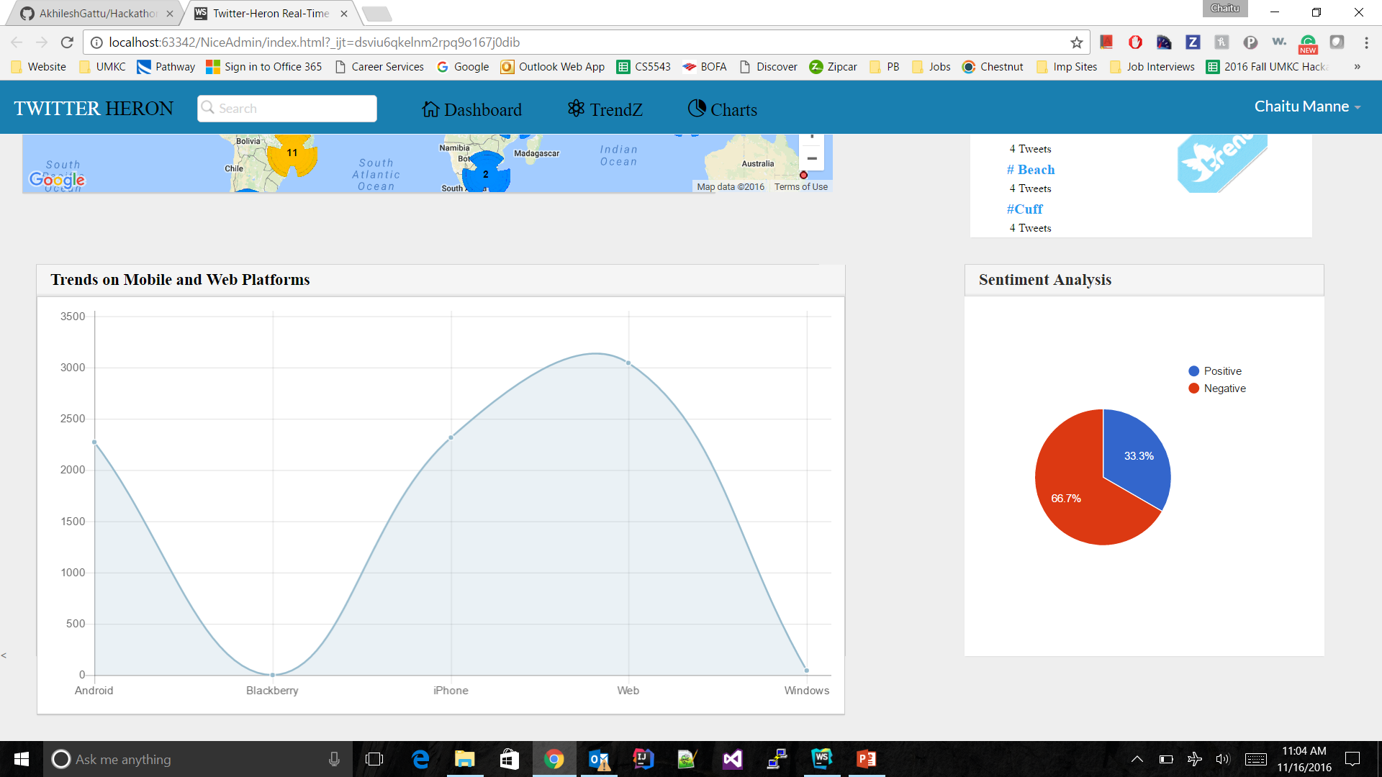
Cont..,

Slide 17
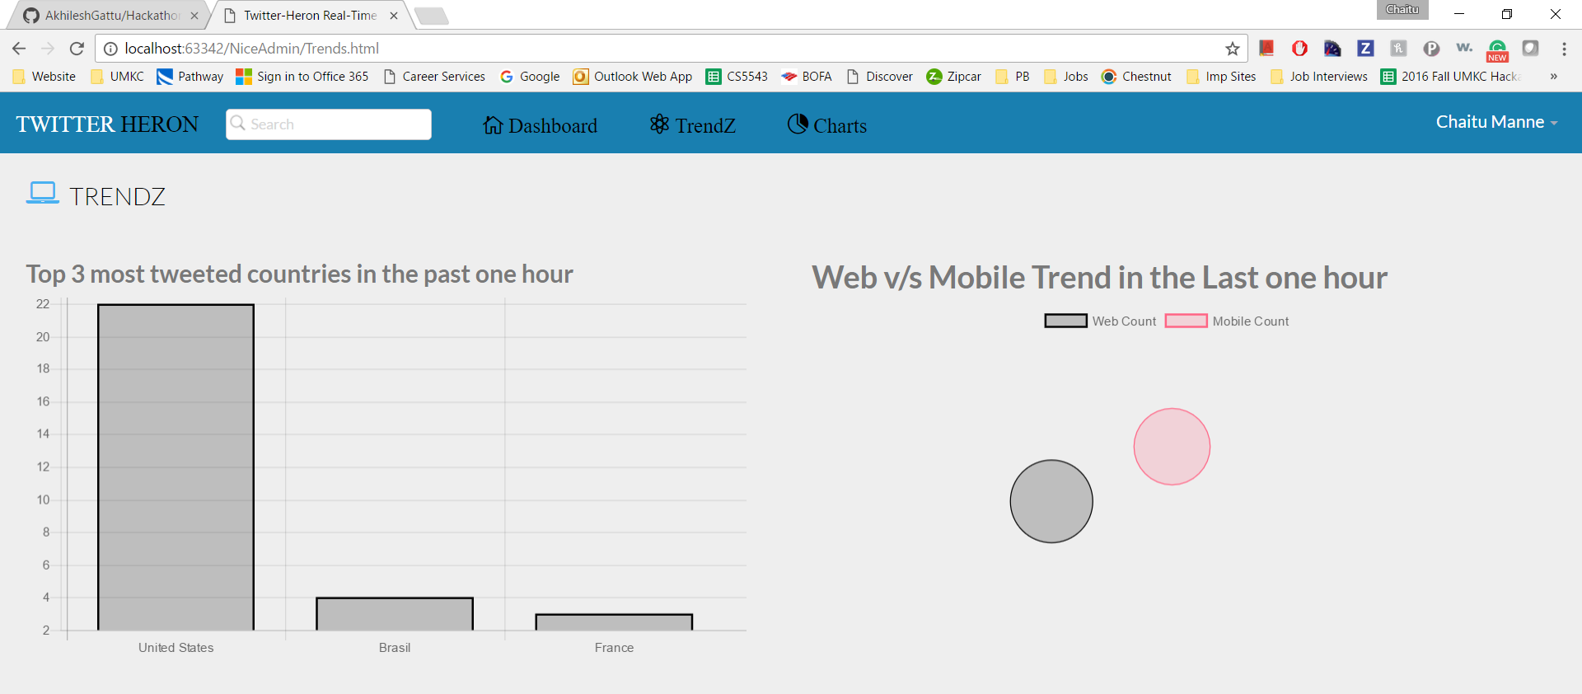
Cont..,

Slide 18


Slide 19


